Slide 1
SYRIATEL CUSTOMER CHURN PREDICTION
By: Michael Muthui Gatero

Slide 2
OVERVIEW
Customer churn is a major challenge in the telecommunications industry, leading to revenue loss and increased customer acquisition costs.
Retaining existing customers is more cost-effective than acquiring new ones, making churn prediction a critical business need.
By leveraging machine learning models, SyriaTel can identify customers at risk of leaving and implement targeted retention strategies to improve customer loyalty and reduce churn.
This study aims to develop an accurate churn prediction model and provide actionable insights to help SyriaTel retain its customers.

Slide 3
BUSINESS AND DATA UNDERSTANDING
Business problem:
SyriaTel faces high customer churn, leading to revenue loss and increased customer acquisition costs. Without proactive measures, the company risks losing market share. Predicting churn helps retain customers through targeted interventions.
Dataset:
The dataset used in this project is the SyriaTel Customer Churn Dataset. It contains approximately 3,333 rows and 21 columns.
The dataset includes various customer attributes such as: call minutes, service usage, contract type, and customer service interactions.
Target variable: Churn (1 = customer left, 0 = customer stayed).
Engineered three new features to enhance model performance:
Total Minutes: Sum of day, evening, and night minutes
Total Calls: Sum of day, evening, and night calls
Total Charges: Sum of day, evening, and night charges
These features provide a more comprehensive view of customer usage patterns and their relationship with churn.

Slide 4
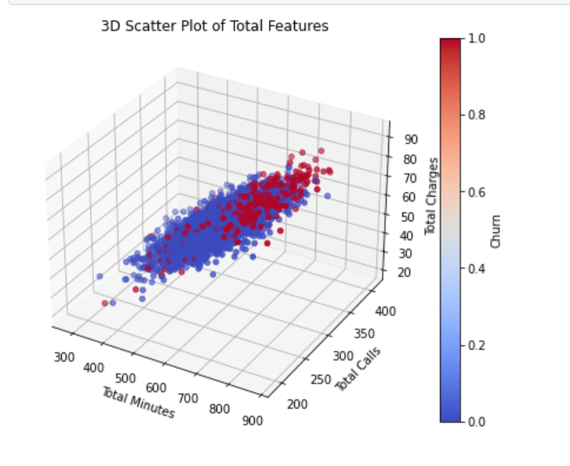
EXPLORATORY DATA ANALYSIS
Conducted exploratory data analysis (EDA) using:
Correlation Heatmap: Showed a strong correlation between total minutes and total charges, confirming their redundancy but importance.
Pairplot: Highlighted differences in feature distributions between churned and non-churned customers.
3D Scatter Plot: Visualized the separation of churned vs. non-churned customers across the new features."

Slide 5
MODELING
Baseline Model:
Implemented a Logistic Regression model, but it struggled with recall for the churn class.
Improved model:
Tested Random Forest, which showed significantly better performance in recall and precision.
Threshold Optimization:
Instead of using the default 0.5 threshold, I optimized the decision threshold by analyzing precision-recall trade-offs to maximize the F1-score for the churn class.
Fine-tuned to balance recall and precision, prioritizing the identification of at-risk customers.

Slide 6
EVALUATION
Key Metrics:
Precision: 73% for the churn class.
Recall: 87% for the churn class.
F1-score: 80% for the churn class.
Overall Accuracy: 93%.
Confusion Matrix:
The confusion matrix shows that the model correctly predicts a significant portion of both churn and non-churn cases while maintaining a balanced trade-off between precision and recall.
Actual/Predicted | No Churn | Churn
No Churn | 534 | 32
Churn | 13 | 88

Slide 7
RECOMMENDATIONS
Target high-risk customers with personalized retention offers.
Enhance customer support by improving service training and reducing wait times.
Introduce flexible pricing plans and contract incentives to increase loyalty.
Monitor customer usage patterns to provide proactive engagement strategies.
Implement a real-time churn monitoring system for quicker intervention.

Slide 8
NEXT STEPS
Deploy the model for real-time churn prediction.
Continuously update and retrain the model with new customer data.
Integrate model insights into SyriaTel’s CRM system for targeted retention strategies.

Slide 9
THANK YOU Any questions?

